Slide 1
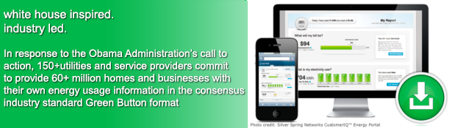
The Green Button Initiative
www.greenbuttondata.org
John Teeter, Presidential Innovation Fellow Alumni,
National Institute of Standards and Technology
john.teeter@nist.gov

Slide 2
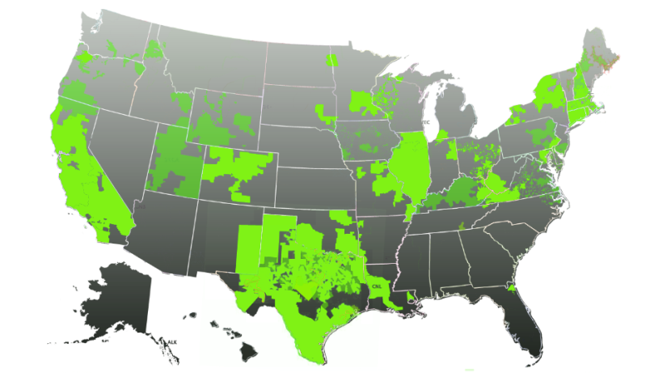
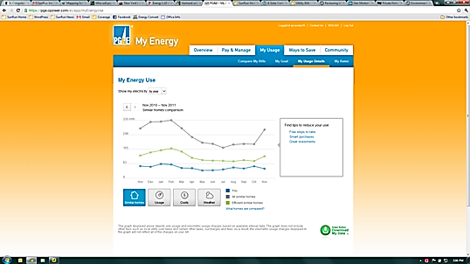


Green Button Across the Nation
Enables electronic consumer access to energy data and supports development of ecosystem (apps)
Available to 60+ million customers in the US and and additional CANADA: 2.6 million+
Result of collaboration among White House, NIST, DOE, state regulators, utilities, vendors, SGIP, and North American Energy Standards Board
Green Button Download My Data and Green Button Connect My Data
Map of US Green Button Commitments

Slide 3
Green Button Evolution
White House Call to Action
Connect My Data Beta Deployments
American Energy Data Challenge
Green Button
CMD Certifications
9/2011
NAESB ESPI Standard Ratified
12/2012
11/2013
4Q 2014
HEY Update w/Green Button
Presidential Memorandum to Federal Agencies
10/2011
First DMD
Available
1/2012
DMD Certifications
Green Button CMD Rollouts
Nationally
DOE Apps for Energy
4/2013
12/2013
2H/2014
5/2012
1H/2015
2011
2012
2014
2013
2015
0 Customers
(Download My Data)
12 Million Customer Accounts*
26 Million Customer
Accounts*
42 Million Customer
Accounts*
* Represents Customer Accounts with Access to Green Button Data – Primarily DMD; Actual Customer download numbers are not available
Notes:
1 – DoE Energy-Apps
a) SDG&E and PG&E released their Green Button support within 90 days of the Call to Action
b) DoE sponsored an Apps for Energy challenge to stimulate ecosystem growth
2 – EPA PM Upgrade: EPA release of API moved Portfolio manager to an Open API platform and set the stage for future Green Button support,
the details of which will be reflected in the EPA portion of the agenda (not wanting to steal their thunder.

Slide 4
NIST Support!
Testing and Certification
Open Source Reference Implementation
Validation tools and Examples
Web Site Development
Ecosystem Outreach
Policy Makers
Utilities
Energy Service Providers
Energy Efficiency Organizations
Consumer Groups
Educational Programs

Slide 5
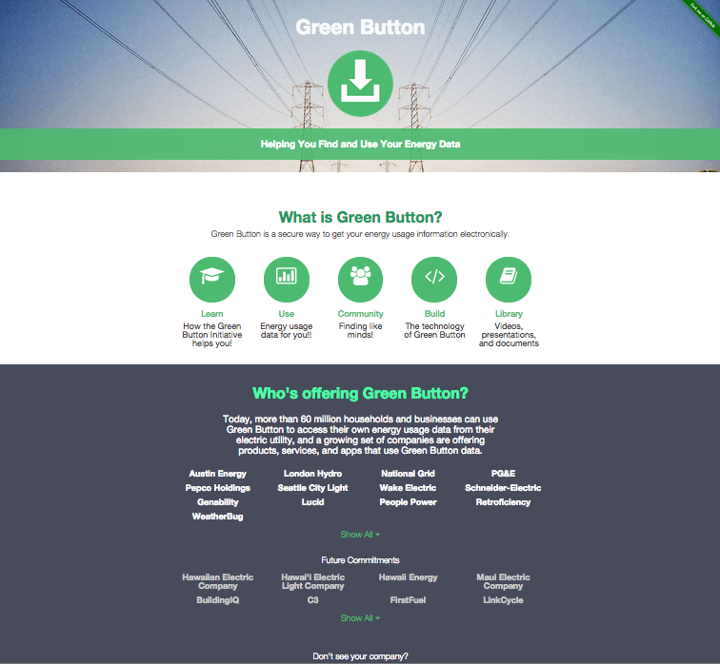
www.greenbuttondata.org
Learn about Green Button
Use Cases for Stakeholder Groups
Index of Communities of Interest
FAQs for various Stakeholders
Tools for CMD and DMD
Library
(Documents/Presentations/Videos)

Slide 6
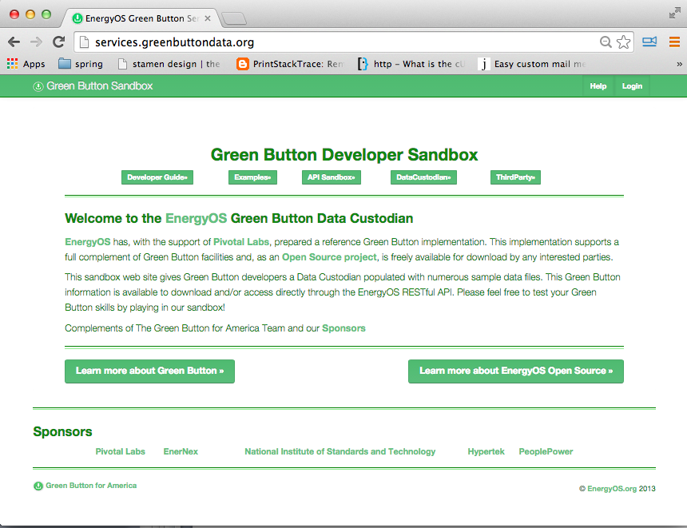
https://services.greenbuttondata.org
Developer Guide (overview of ESPI resources)
Sample Data
RESTful API Sandbox
DataCustodian Sandbox
ThirdParty Sandbox
Provides Functioning
Green Button Data Custodian
and Third Party Applications
with RESTful API access.

Slide 7

Green Button Certification
Download My Data will be announced SOON!
Connect My Data Testing Being Designed
There is pull from the user community
Implementations awaiting certification testing
http://www.ucaiug.org/GreenButton
http://www.greenbuttondata.org/community
(UCAIug OpenADE Task Force)

Slide 8
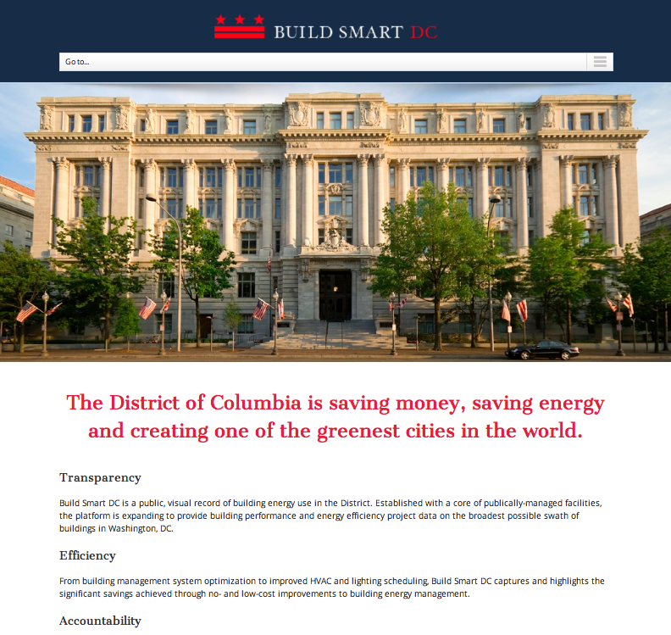
Green Button Connect My Data In Washington DC Governmental Services
Providing 15 Minute
Interval Data for 400+
Buildings in Washington
Local Utility (Pepco)
Providing first in the
Nation deployment with
Green Button Connect
My Data inside!
Available throughout
Pepco Service Area

Slide 9
US Federal Government Commitment
Climate Action Plan
“The Administration will leverage the ‘Green Button’ standard – which aggregates energy data in a secure, easy to use format – within federal facilities to increase their ability to manage energy consumption, reduce greenhouse gas emissions, and meet sustainability goals.” The President’s Climate Action Plan, June 25, 2013
Presidential Memorandum (to all Federal agencies)
“Sec. 3. Building Performance and Energy Management .. each agency shall: … incorporate Green Button into reporting, data analytics and automation, and processes, in consultation with local utilities …” [.. GSA, EPA pilots …] Presidential Memorandum on Federal Leadership in Energy Management, December 5, 2013

Slide 10

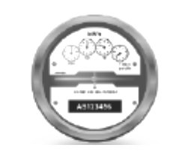


Deployed Use Case for GSA Energy Management
Contracted Service Provider
Analytics
Virtual Energy Audits
…
Utility
MDM
Portal
Agency/Owner
Management
Benchmarking
…
Utility
Meter
Building
Energy Management System (EMS)
Sub-Meter 1
Sub-Meter 2
…
Energy Manager
Notes:
Brian overlay – clean up arrows

Slide 11

Information for YOU!
Thank You

